Slide 1
I Love Big
Weatherman's calling for rain and cloudy skies But in my heart it's always sunny and 75
Been that way ever since I was a kid
That's just me, I love big.
The way I laugh, the way I smile
The way I hug a friend I haven't seen in a while
It's who I am, it's how I live
I love big
Go be brave, go be brave
Don't be afraid going for the gold
It's who we are, it's how we live
I love big
-by and about Children with Williams Syndrome

Slide 2
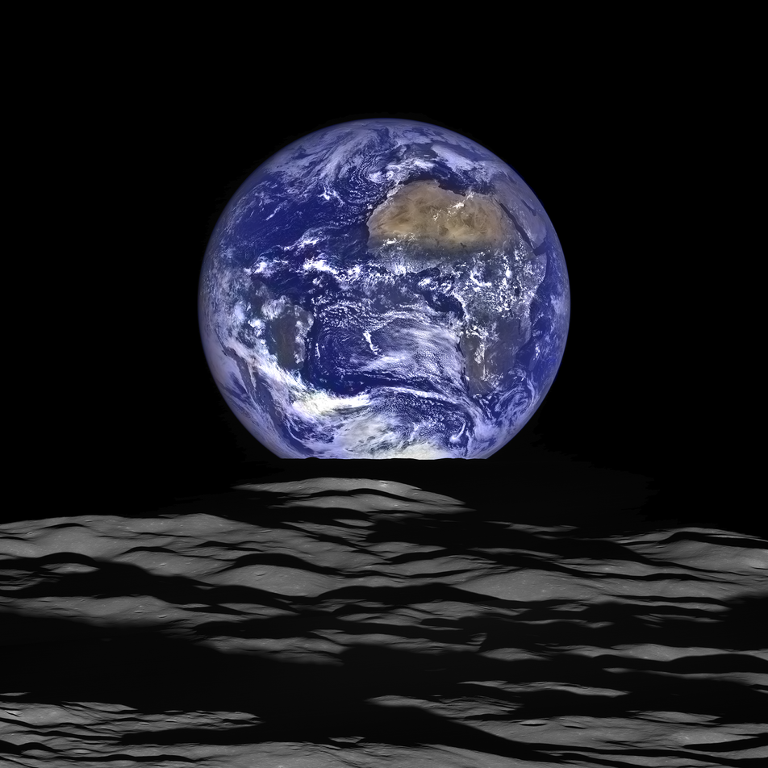

Slide 3
Poetry
https://www.poets.org/poetsorg/poem/sick

Slide 4
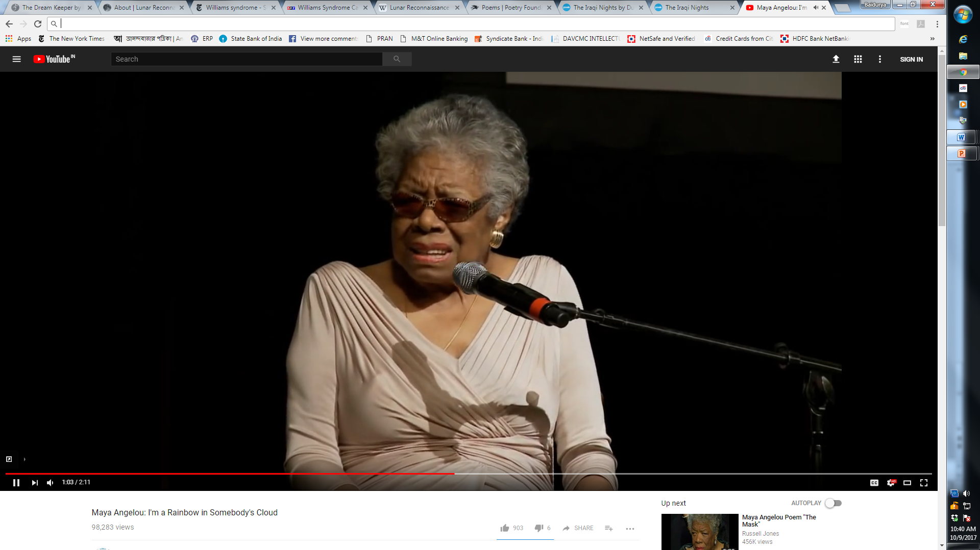
Poets in their Own Words
https://www.youtube.com/watch?v=XOe9ygczcMA

